Slide 1
Software Cost Estimation

Slide 2
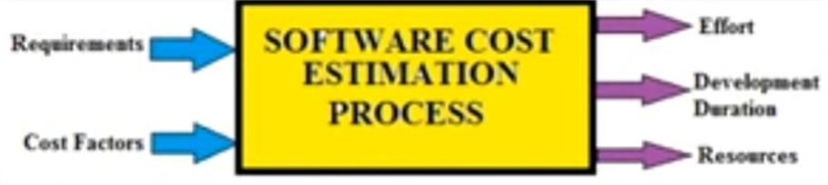
Software Cost Estimation
The Software Cost Estimation is a process of predict /estimate the approximate cost of the software project before the development starts.
Cost estimation models are some mathematical algorithms or parametric equations that are used to estimate the cost of a product or a project.
Factors considering for Project Budgeting:
Specification & Scope
Location
Duration
Project Team Efforts
Resources
1

Slide 3
Tools and techniques
Expert Judgment:
The experts are the people who have prior knowledge on similar kind of projects.
So they can suggest valuable insight based on their experience.
You can also take their advice on various tools and techniques that can be used to estimate similar kind of project.
Analogous Estimation:
It uses historical data from similar projects like scope, budget, duration, size, weight and complexity etc.
It measures the current project on that basis and does the estimation.
It used in the early phases of a project and is less costly, time & accurate than other methods.
1

Slide 4
Tools and techniques
Parametric Estimation:
It analyze a past project and get the man-hours for each unit.
Then it estimate the total man-hour for the new project's activity.
It use statistical modelling technique to identify both cost and time for current project using data from past projects.
Bottom-up Estimation:
In WPS, All the project is divided into smaller work packages & cost of each work package is estimated one by one.
It estimate every single activity and rolling them up into an overall project estimate.
It is a time consuming and costly technique but it provides the most accurate estimation.
1

Slide 5
Tools and techniques
Three-Point Estimation:
To deal with uncertainties and risk PERT (Program Evaluation and Review Technique) method is used.
Most Likely Estimate: Assuming a normal case in which everything goes as usual.
Pessimistic Estimate: Assuming everything goes wrong i.e. worst case scenario.
Optimistic Estimate: Assuming everything goes as planned i.e. best case scenario.
1

Slide 6
Tools and techniques
Reserve Analysis:
It is important to keep the reserve budget to deal with uncertain events.
Project manager need to take approval from the sponsors for management of reserve budget.
Cost of Quality:
Includes money spent during the project to avoid failures and money spent during & after the project due to failures.
Vendor Bid Analysis:
Used to estimate what the project should cost by comparing the bids submitted by multiple vendors.
1

Slide 7
COCOMO Model
It was developed by a scientist Barry Boehm in 1981.
The COCOMO (Constructive Cost Model) is one of the most popularly used software cost estimation models.
This model depends on the size means number of lines of code for software product development.
It estimates Effort required for project, Total project cost & Scheduled time of project.
1

Slide 8
Software Project Types
In COCOMO, projects are categorized into three types:
1. Organic Type:
Project is small and simple (2-50 KLOC)
Few Requirements of projects.
Project team is small with prior experience.
The problem is well understood and has been solved in the past.
Examples: Simple Inventory Management Systems & Data Processing Systems.
1

Slide 9
Software Project Types
2. Semidetached Type:
Medium size and has mixed rigid requirements. (50-300 KLOC)
Project has Complexity not too high & low.
Both experienced and inexperienced members in Project Team.
Project are few known and few unknown modules.
Examples: Database Management System, Difficult inventory management system.
3. Embedded Type:
Large project with fixed requirements of resources. (More than 300 KLOC)
Larger team size with little previous experience.
Highest level of complexity, creativity and experience requirement.
Examples: ATM, Air Traffic control, Banking software.
1

Slide 10
Types of COCOMO Model
Basic COCOMO Model
Intermediate COCOMO Model
Complete/ Detailed COCOMO Model
1

Slide 11
Basic COCOMO Model Overview
Key Characteristics:
It is a type of static model to estimates software development effort quickly and roughly.
It mainly deals with the number of lines of code in project.
1

Slide 12
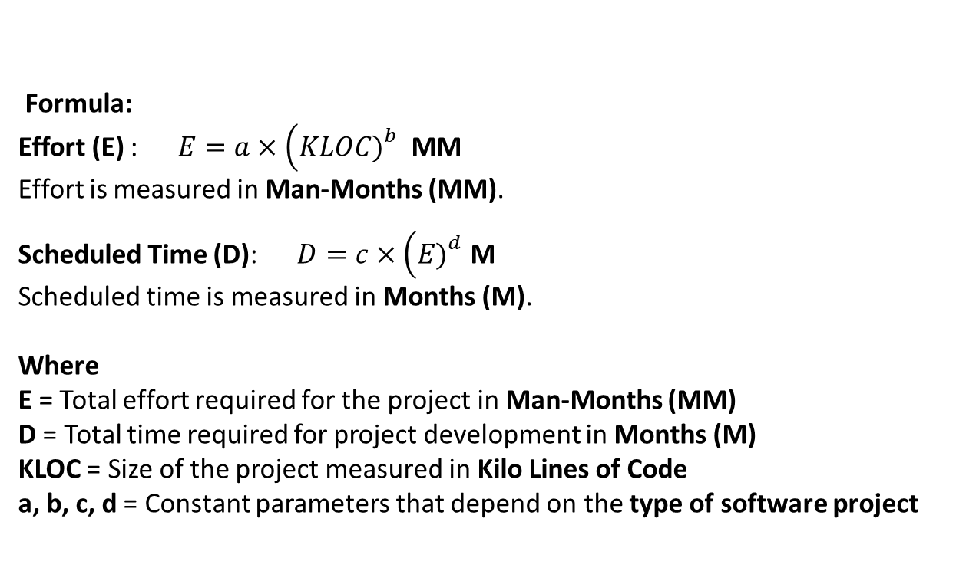
Basic COCOMO Model Overview
Formula:
Effort (E) : $E=a×\left(KLOC{\left.)\right.}^{b}\right.$ MM
Effort is measured in Man-Months (MM).
Scheduled Time (D): $D=c×\left(E{\left.)\right.}^{d}\right.$ M
Scheduled time is measured in Months (M).
Where
E = Total effort required for the project in Man-Months (MM)
D = Total time required for project development in Months (M)
KLOC = Size of the project measured in Kilo Lines of Code
a, b, c, d = Constant parameters that depend on the type of software project
1

Slide 13
Basic COCOMO Model Overview
Project Type | a | b | c | d
Organic | 2.4 | 1.05 | 2.5 | 0.38
Semi-detached | 3.0 | 1.12 | 2.5 | 0.35
Embedded | 3.6 | 1.20 | 2.5 | 0.32
1

Slide 14
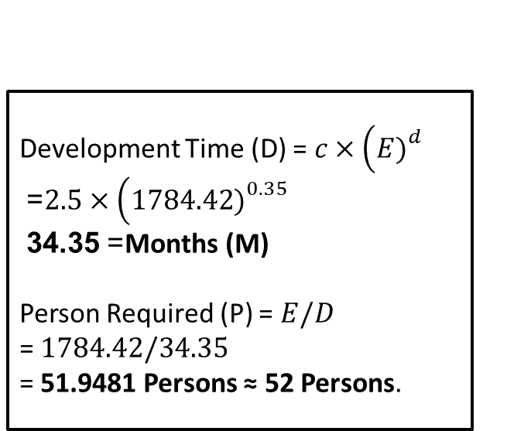
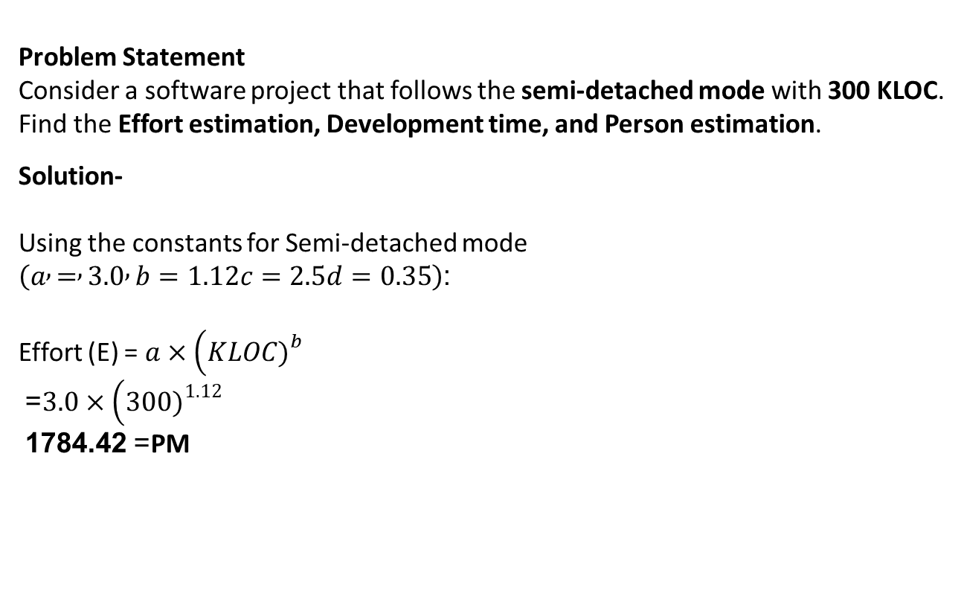
Basic COCOMO Model Overview
Problem Statement
Consider a software project that follows the semi-detached mode with 300 KLOC. Find the Effort estimation, Development time, and Person estimation.
Solution-
Using the constants for Semi-detached mode $\left(a , = , 3.0 , b=1.12c=2.5d=0.35\right)$:
Effort (E) = $a×\left(KLOC{\left.)\right.}^{b}\right.$ = $3.0×\left(300{\left.)\right.}^{1.12}\right.$ = 1784.42 PM
Development Time (D) = $c×\left(E{\left.)\right.}^{d}\right.$ = $2.5×\left(1784.42{\left.)\right.}^{0.35}\right.$ = 34.35 Months (M)
Person Required (P) = $E/D$ = $1784.42/34.35$ = 51.9481 Persons ≈ 52 Persons.
1

Slide 15
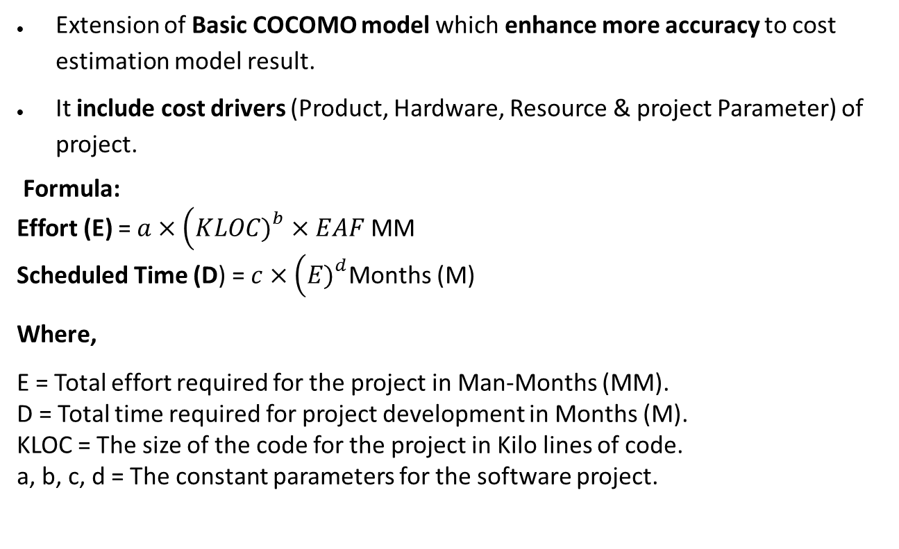
Intermediate COCOMO Model
Extension of Basic COCOMO model which enhance more accuracy to cost estimation model result.
It include cost drivers (Product, Hardware, Resource & project Parameter) of project.
Formula:
Effort (E) = $a×\left(KLOC{\left.)\right.}^{b}×EAF\right.$MM
Scheduled Time (D) = $c×\left(E{\left.)\right.}^{d}\right.$Months (M)
Where,
E = Total effort required for the project in Man-Months (MM). D = Total time required for project development in Months (M). KLOC = The size of the code for the project in Kilo lines of code. a, b, c, d = The constant parameters for the software project.
1

Slide 16
Intermediate COCOMO Model
Effort Adjustment Factor (EAF)
EAF is calculated by multiplying the parameter values of different cost driver parameters. For ideal, the value is 1.
Product Attributes
Parameter | Very Low | Low | Nominal | High | Very High
Required Software Reliability | 0.75 | 0.88 | 1 | 1.15 | 1.40
Size of Project Database | NA | 0.94 | 1 | 1.08 | 1.16
Complexity of the Project | 0.70 | 0.85 | 1 | 1.15 | 1.30
1

Slide 17
Intermediate COCOMO Model
Hardware Parameters
Parameter | Very Low | Low | Nominal | High | Very High
Performance Restriction | NA | NA | 1 | 1.11 | 1.30
Memory Restriction | NA | NA | 1 | 1.06 | 1.21
Virtual Machine Environment | NA | 0.87 | 1 | 1.15 | 1.30
Required Turnabout Time | NA | 0.94 | 1 | 1.07 | 1.15
1

Slide 18
Intermediate COCOMO Model
Personnel Parameters
Parameter | Very Low | Low | Nominal | High | Very High
Analysis Capability | 1.46 | 1.19 | 1 | 0.86 | 0.71
Application Experience | 1.29 | 1.13 | 1 | 0.91 | 0.82
Software Engineer Capability | 1.42 | 1.17 | 1 | 0.86 | 0.70
Virtual Machine Experience | 1.21 | 1.10 | 1 | 0.90 | NA
Programming Experience | 1.14 | 1.07 | 1 | 0.95 | NA
1

Slide 19
Intermediate COCOMO Model
Project Parameters
Parameter | Very Low | Low | Nominal | High | Very High
Software Engineering Methods | 1.24 | 1.10 | 1 | 0.91 | 0.82
Use of Software Tools | 1.24 | 1.10 | 1 | 0.91 | 0.83
Development Time | 1.23 | 1.08 | 1 | 1.04 | 1.10
1

Slide 20
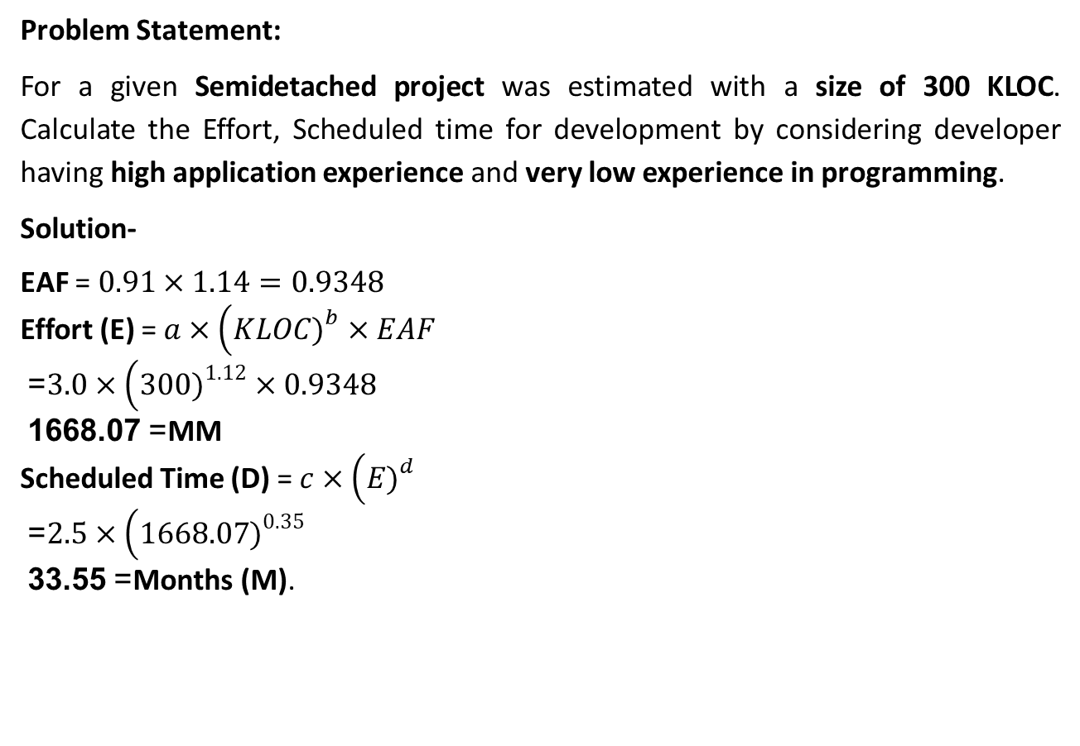
Intermediate COCOMO Model
Problem Statement:
For a given Semidetached project was estimated with a size of 300 KLOC. Calculate the Effort, Scheduled time for development by considering developer having high application experience and very low experience in programming.
Solution-
EAF = $0.91×1.14=0.9348$
Effort (E) = $a×\left(KLOC{\left.)\right.}^{b}×EAF\right.$ = $3.0×\left(300{\left.)\right.}^{1.12}×0.9348\right.$ = 1668.07 MM
Scheduled Time (D) = $c×\left(E{\left.)\right.}^{d}\right.$ = $2.5×\left(1668.07{\left.)\right.}^{0.35}\right.$ = 33.55 Months (M).
1

Slide 21
Detailed/Complete COCOMO Model
The model incorporates all qualities of both Basic COCOMO and Intermediate COCOMO strategies on each software engineering process.
The whole software is divided into different modules and then apply COCOMO in different modules to estimate effort and then sum the effort.
The Six phases of detailed COCOMO are:
Planning and requirements
System design
Detailed design
Module code and test
Integration and test
Cost Constructive model
1

Slide 22
Example: Detailed COCOMO
Problem Statement: A distributed Management Information System (MIS) product for an organization having offices at several places across the country can have the following sub-components:
Database part
Graphical User Interface (GUI) part
Communication part
Solution:
The communication part can be considered as Embedded software.
The database part could be Semi-detached software.
The GUI part Organic software.
The costs for these three components can be estimated separately and summed up to give the overall cost of the system.
1

